Slide 1

DATA SCIENCE HOUSING PROJECT
KING COUNTY HOUSING ANALYSIS USING MULTIPLE REGRESSION

Slide 2
OVERVIEW OF BUSINESS PROBLEM AND BUSINESS QUESTION
Business problem:
Realtors in King County are looking for credible information that would guide them while offering advice to home owners who want to sell their homes in regards to the feature that they can renovate or add to their homes in order to improve the value of their homes before listing.
Business question:
What are some of the home features that home owners need to improve or to add to their homes in order to ensure a higher value for their homes?

Slide 3

DATA UNDERSTANDING and business understanding
Stakeholder: Real Estate companies in King county
Data source: King County House Sales dataset
Business aim: Use data driven insights to provide useful recommendations to the Real Estates Entities with which they will use to advice home owners accordingly.

Slide 4

DATA PROCESSING AND CLEANING
The data cleaning process was done in the following stages:
Handling missing values
Removing outlier
Exploring correlations and multi-collinearity features
Creating dummy variables.

Slide 5

MODELLING OF THE DATA
USING REGRESSION MODELS
Modelling of the data is done through the use of regression models.
Development of the models aids in accurate estimation of the price as the target variable in relation to the different features in order to determine the features that are most influential and by what amount does their improvement relate to change in the price of the home

Slide 6
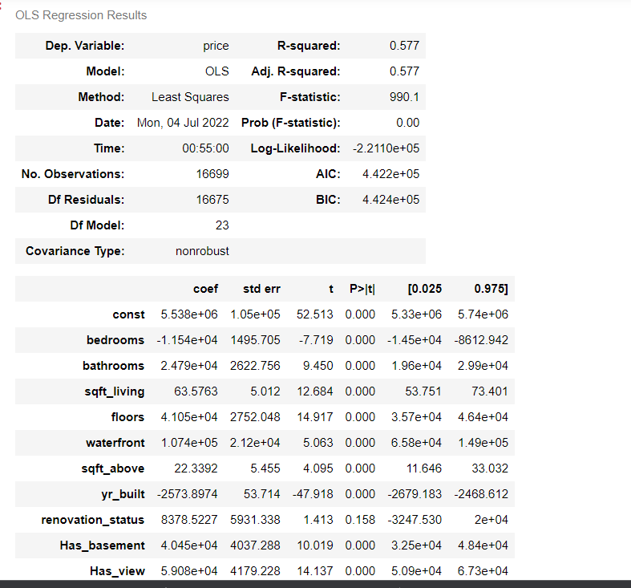
MODEL EXAMPLE
Best regression model
Features contained
This model considers all the home features except the renovation-status , poor condition and luxury grade which do not show any correlation to price.

Slide 7

REGRESSION RESULTS
While holding all other variables constant, addition of a basement to a home increases sale price by 40,450 dollars
While holding all other variables constant, the addition of a bathroom increases sale price by 24,020 dollars
While holding all other variables constant, the addition of one floor level increases sale price by 41,050 dollars
While holding all other variables constant, improving a home's condition from Average to Very Good increases sale price by 42,180 dollars
While holding all other variables constant, increasing the sqft_living of a home increases sale price by 63.75 dollars
While holding all other variables constant, having a waterfront in a home increases sale price by 10,740 dollars
While holding all other variables constant, improving a home's grade from Better to High Quality increases sale price by 72,690 dollars

Slide 8
Recommendations
Home owners should increase the sqft_living since an increase per inch raises the value by 63.75 dollars. Lets assume there's a 1000 inch increase, there's an estimated increase in value by 63,750 dollars.
Home owners should renovate their houses by increasing the number of bedrooms, having a basement, having a waterfront, improve condition of the house to meet very good , add additional floors and improve the grade to high quality in order to maximize value of their homes before listing.

Slide 9

Further research and next steps
Our model only scored an adjusted R-value of 57.7% but I believe with the introduction of polynomial regression models the approximation will be more accurate.
Other than that, more information regarding the variables should be researched into.

Slide 10

Thank You
By faith leo

